Slide 1
3-dars(Model Building)
Davronbek Malikov

Slide 2

Bugun
Takrorlash
Codewars
Model Evaluation
Regression
Linear Models
Linear Regression
Funksiya + DP
Vazifa

Slide 3
Takrorlash

Slide 4
Takrorlash
Model Evaluation
Classification
Linear models
Logistic Regression
Funksiya va ML

Slide 5
Codewars

Slide 6
Model Evaluation

Slide 7
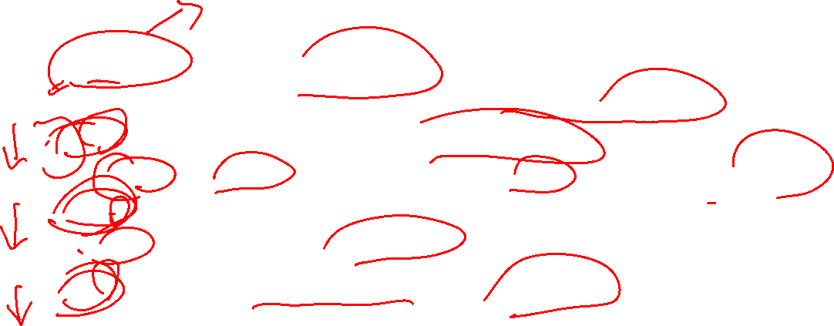
Model Evaluation
R2 squared---- compare qilishda
Model datasetdagi o’zagrishlarni qancha darajada tushunganini o’lchaydi
MSE(Mean Squared Error)---koproq ichkarida
Y_pred bn Y_actual orasidagi kvadratik farqlarning o’rtachasini xisoblaydi
RMSE(kvadrat ildizli o’rtacha kvadratik xatolik)
MSE ning kvadrat ildizi---tashqarida
MAE---o’ratacha absolute xatolik--- tashqarida

Slide 8
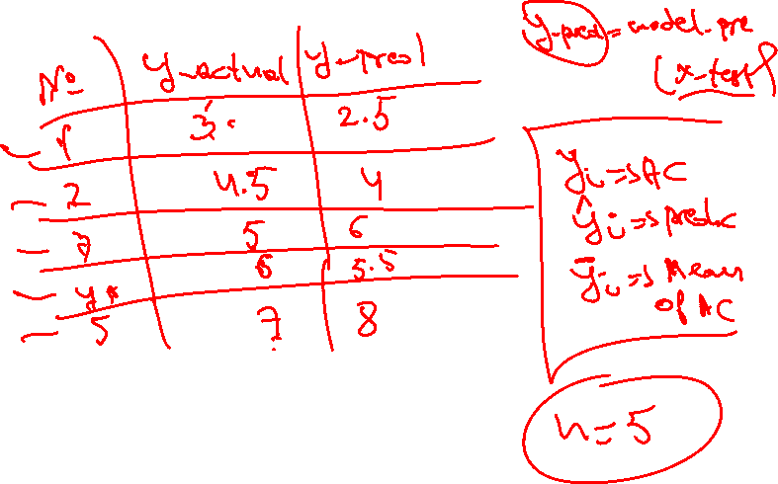
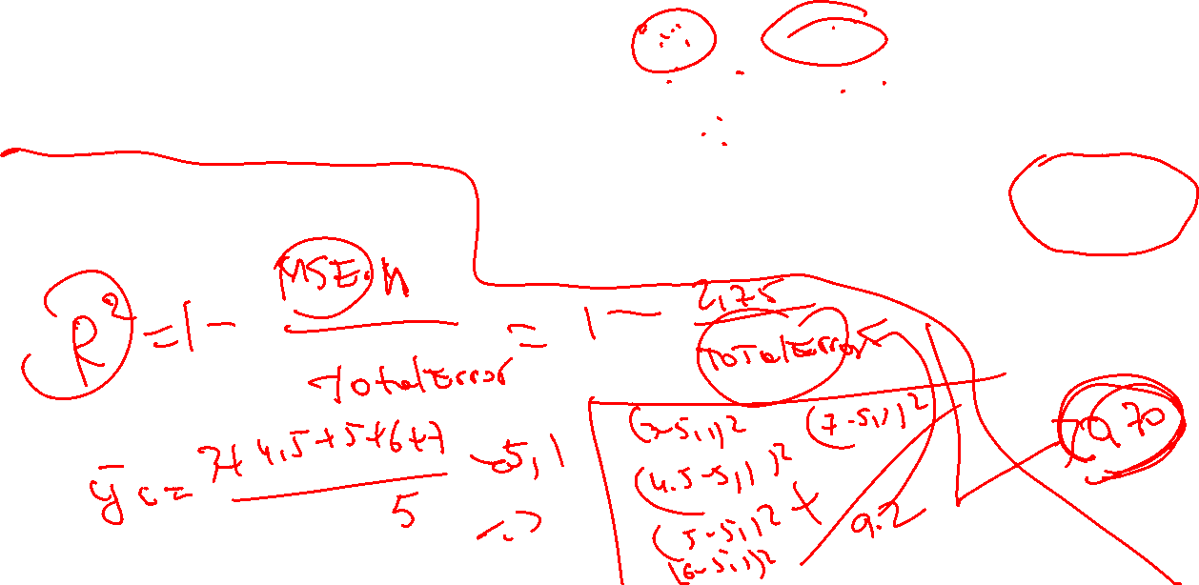
R2
R2_score

Slide 9
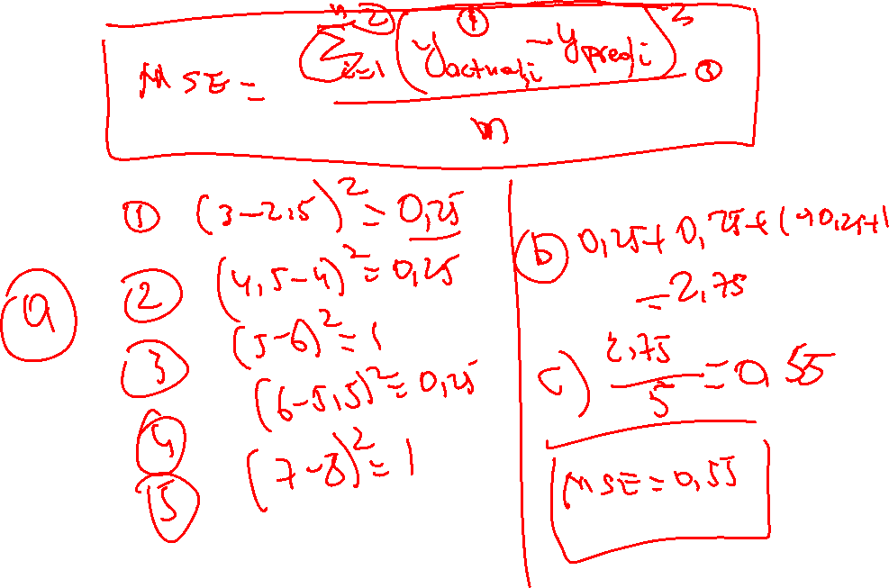
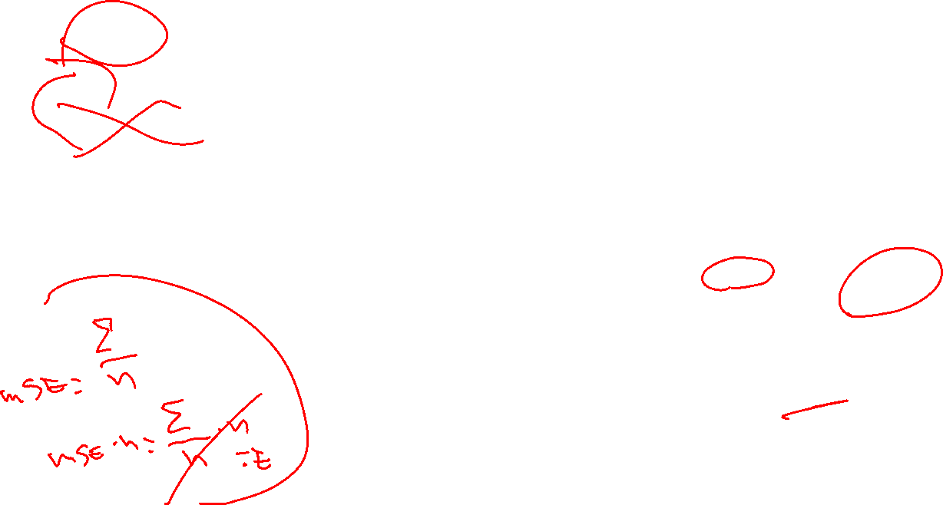
MSE
R2_score

Slide 10

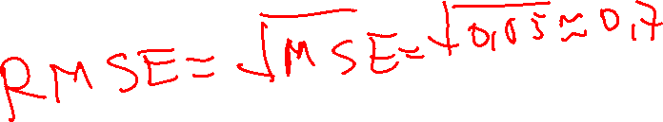
RMSE
RMSE=sqrt(MSE)

Slide 11
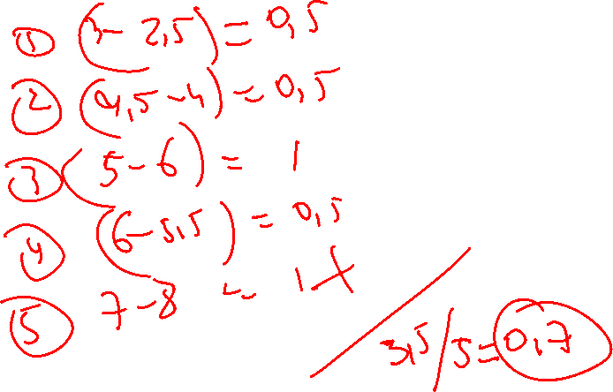
MAE
MAE

Slide 12
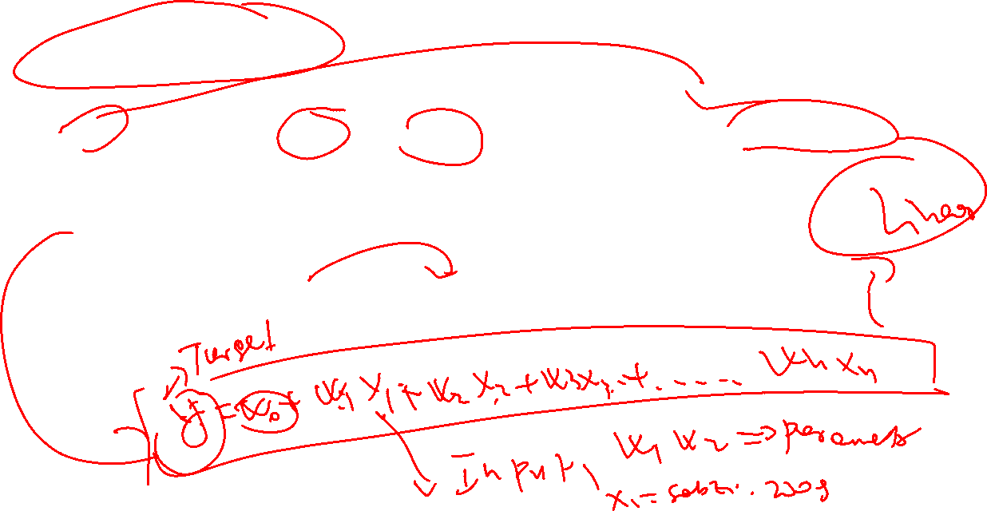
Linear Models
Linear Models--- feature va target qiymatlar orasidagi chiziqli aloqa bor deb faraz qiladi
Eng kop foydalaniladigan model
Equation
Asosiy maqsad: Actual va predicted qiymatlar orasidagi farqni kamaytirish

Slide 13

Vazifa
Kaggle va Githubdan dataset toping va Linear regression va Logistik regressionga 2 ta alohida loyiha qiling
Fuksiyani ishlating
Model Evaluationni ishlating
Codewars
Royhatdan o’ting
8Kyudan boshlang
Nazariy malumot va tushunchalarni takrorlang

